Slide 1
History
Late 1990’s Kevin Peterson wanted to improve DM care in PCP offices
Did literature search on modalities that would be effective
He found nine that were put into the acronym TRANSLATE
Did successful randomized control trial in over 8,000 diabetic patients
It was modified and adapted for a 40 practice NIH R-01 pragmatic clinical trial comparing Computer Decision support to facilitated support
TRANSLATE Rubric was developed for evaluation

Slide 2
TRANSLATE
Target
Reminder
Administrative Buy-In
Network Information System
Site Coordinator
Local Clinician Champion
Audit and Feedback
Team Approach
Education

Slide 3
Target
Goal setting
Needs to be
  Clear Measurable and feasible
Common office problems
  No targets
  Trying to do too many things at once

Slide 4
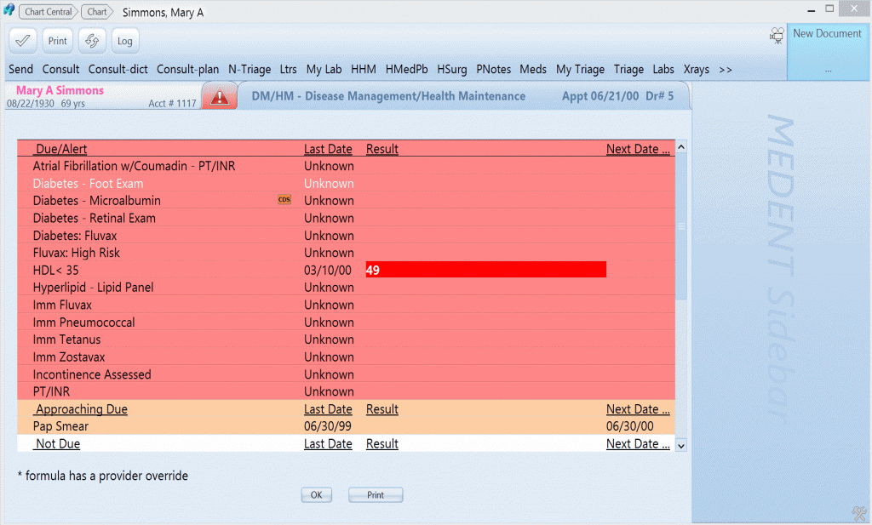
Reminder
Actionable information at the point of care

Slide 5

Administrative Buy-in
Commitment of Resources
  Money
  Personnel

Slide 6
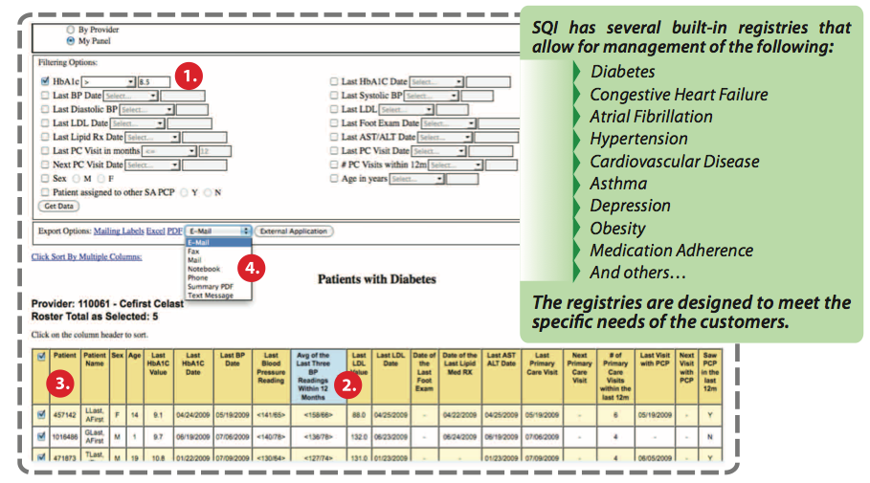
Networked Information Systems
Population Heatlh
  Registries
  Prefereably easily created

Slide 7

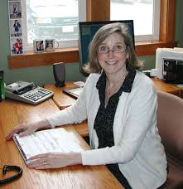
Site Coordinator
Local accountability
Usually a nurse or office manager
Single point of contact for the PF
Arrangement of team meetings
Arrangement of education for the staff
Responsible for appropriate data collection

Slide 8

Local Clinician Champion
For Clinician buy-in
  Explanation of Evidence Base
Does not have to be MD (but usually is)
  NPs and PAs have done a good job with this
    Large regional variation
    Some only accept MD

Slide 9
Audit and Feedback
Longitudinal Reports
  How the practice is progressing over time
Benchmarking Reports
  How the practice is doing compared to others

Slide 10
Team Approach
Regular meetings
Broad input on workflow and process plans
Allowing people to work to the top of their license
Huddles (brief micro-team meetings) have also shown success

Slide 11
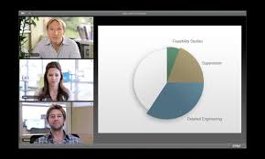
Education
Training in all its forms:
  Academic Detailing*
  Collaborative Learning Groups}*
  In-service
  CME etc
* Most commonly used in practice transformation

Slide 12
TRANSLATE Scoring Rubric
Translate element | 1 | 2 | 3 | 4 | Score
Targets | No targets set | Vague or non-measurable targets | Clear, measurable, but not feasible targets | Clear, measurable and feasible targets
Reminders | No Reminders available | Reminders available but never used | Reminders available but used infrequently | Reminders routinely used
Administrative buy-in (Resource allocation) | Leaders resistant | Leaders agreeable but unwilling to commit resources (cool) | Leaders agreeable and willing to commit limited resources (lukewarm) | Leader willing to commit all resources necessary (enthusiastic)
Network Information Systems (Registries) | No information system or unable to create registries | Able to create registries but none created | Few registries created or used < 3 conditions | Registries created and used for at least 3 conditions
Site Coordinator | No site coordinator identified | Site coordinator identified but has no time for QI activities | Site coordinator has limited time to do QI | Site coordinator with clear mission, resources, and personnel to complete QI work
Local Physician Champion | Not identified | Identified but uninvolved (name only) | Lukewarm support | Enthusiastic support
Audit and Feedback | Never done | Reports available but not disseminated | Reports disseminated occasionally and only at the practice level | Individual reports disseminated at least 2 times per year
Team approach | No teams formed | Limited teams that function from a top down approach | Limited teams that get input from just a few individuals | Non-hierarchical broadly based teams
Education - CME, collaborative learning groups, staff training | No opportunities for education | Rare educational opportunities | Occasional educational opportunities | Frequent educational opportunities
Total score for all elements at benchmark |  |  |  |  | 0.0

Slide 13
Preliminary Results
Total Score

Slide 14
Change by Individual element (all practices)

Slide 15
Individual elements for individual practice

